Slide 1


Slide 2

Food security is defined as the availability of food and one's access to it. A household is considered food secure when its occupants do not live in hunger or fear of starvation.
Food security means availability, accessibility and affordability of food to all people at all times.

Slide 3
availability of food means food production within the country, food imports and the previous years stock stored in government granaries.
accessibility means food is within reach of every person.
affordability implies that an individual has enough money to buy sufficient, safe and nutritious food to meet one's dietary needs.

Slide 4

enough food is available for all the persons
all persons have the capacity to buy food of acceptable quality and
there is no barrier on access to food.

Slide 5

For poorest section of the society
persons above the poverty line might also be food insecure when the country faces a national disaster/calamity like earthquake, drought, flood, tsunami, widespread failure of crops causing famine, etc.

Slide 6



Drought takes place
Total production of food falls
Shortage of food in effected areas
Prices will go up
Some people cannot afford Leads to food insecurity.

Slide 7

Poor people sometimes cannot buy enough foodstuffs and thereby fail to fulfill the calorie demands of the body. Food scarcity in the society. This causes decreased supply of food to the whole of the population, and thus mass starvation may occur.

Slide 8

A massive starvation might take a turn of famine.
A Famine is characterised by wide spread deaths due to starvation and epidemics caused by forced use of contaminated water or decaying food and loss of body resistance due to weakening from starvation.

Slide 9
 The most devastating famine that occurred in India was the FAMINE OF BENGAL in 1943.
This famine killed thirty lakh people in the province of Bengal

Slide 10

 Between 2.1 and three million people died as a result of crop failure, the exporting of foods by India's British administration to Allied soldiers fighting in World War Two, the end of rice imports from Burma following Japanese invasion and a lack of food price controls by the British administration.

Slide 11
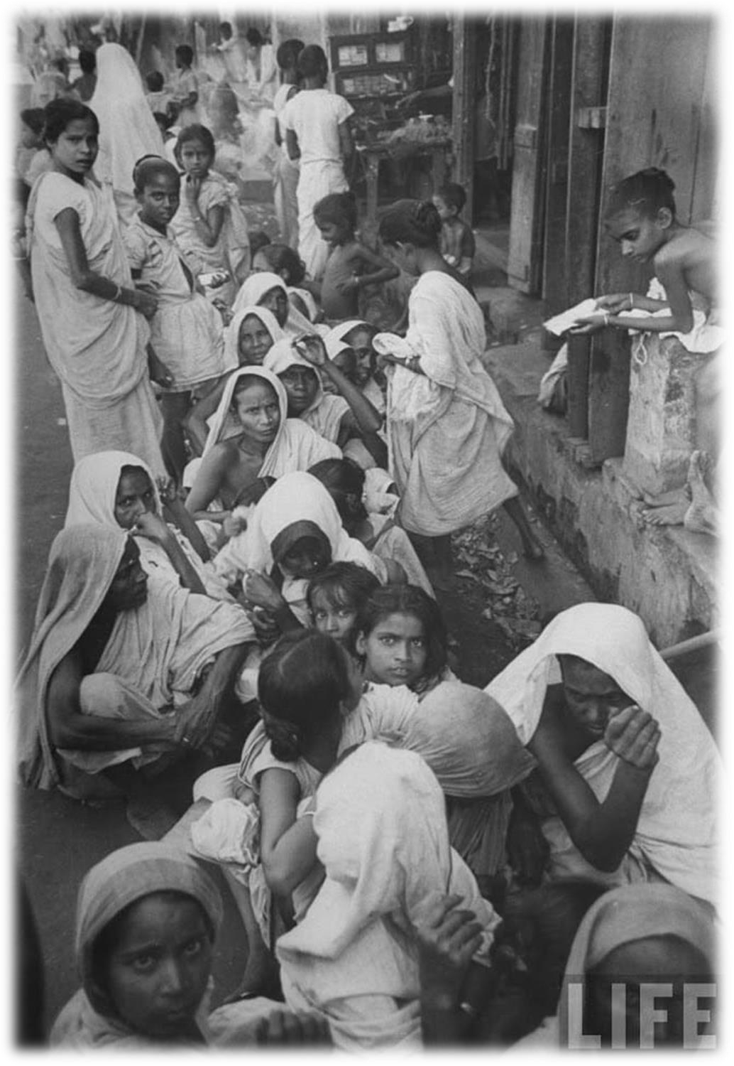
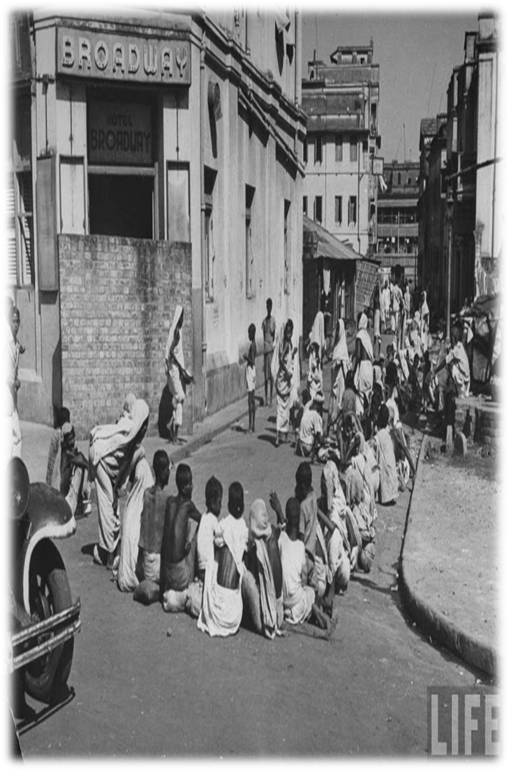

Slide 12

 China 1958-62
Soviet Union 1921-22
Soviet Union (Ukraine) 1932-34
North-west China 1927
China (Henan) 1943
North Korea 1995-99
India (Bengal) 1943
China (Hunan) 1929
Soviet Union (Ukraine and Belorussia) 1946- 47
Cambodia 1979

Slide 13

It is disturbing to note that even today, there are places like
Kalahandi and Kashipur in Orissa where famine- like conditions have been existing for many years and where some starvation deaths have also been reported.
Starvation deaths are also reported in Baran district of Rajasthan, Palamau district of Jharkhand and many other remote areas during the recent years.
Therefore, food security is needed in a country to ensure food at all times.

